Slide 1
Docker
Kubernetes
Presented By : Shwetali Berad

Slide 2
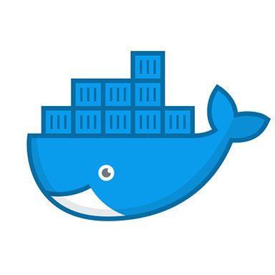
Agenda for Docker
What is Docker?
VM vs Container
Docker Architecture
Images and Containers
Managing Data in Docker
Volumes
Bind Mounts
tmpfs
Networking in Docker
Host
Bridge
None
Overlay
Notes:
<number>

Slide 3
What is Docker?
Docker is an open platform for developing, shipping, and running applications.
Docker enables you to separate your applications from your infrastructure so you can deliver software quickly.
Docker provides the ability to package and run an application in a loosely isolated environment called a container.

Slide 4
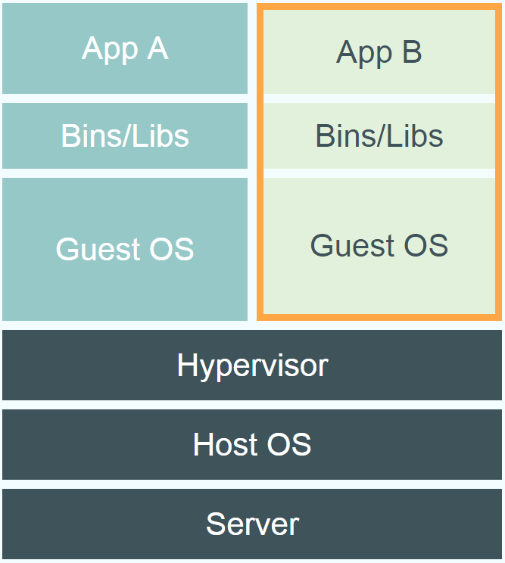
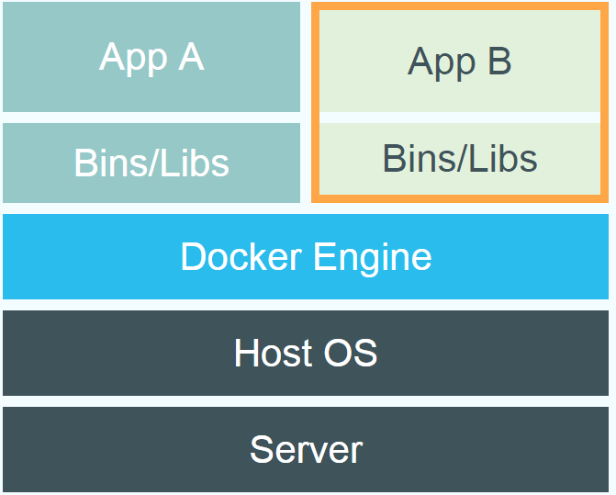
VM vs Docker

Slide 5
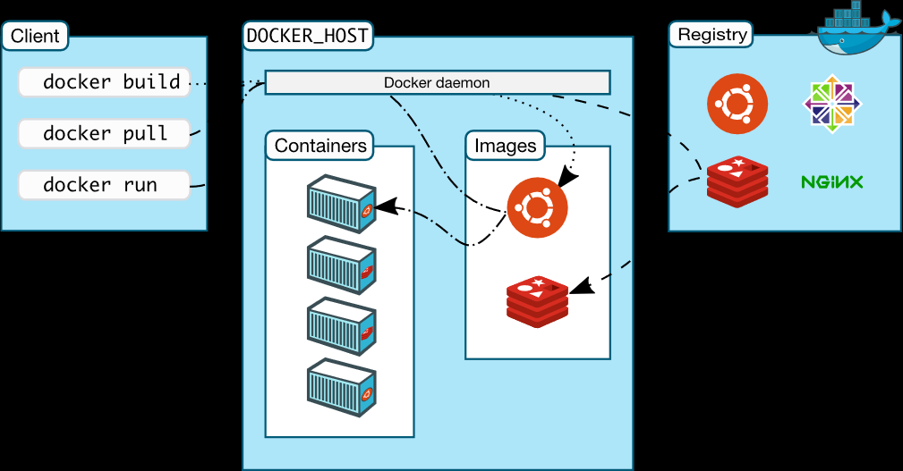
Docker Architecture

Slide 6
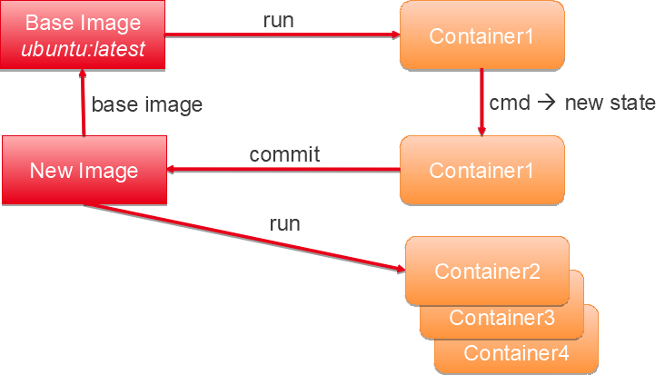
Images and Containers
A container is a runnable instance of an image
An image is a read-only template with instructions for creating a Docker container.

Slide 7
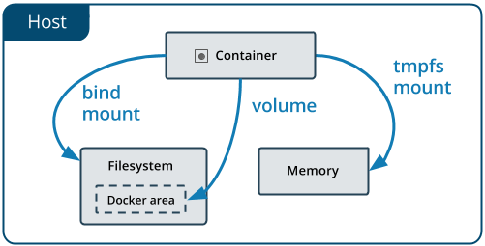
Managing Data in Docker

Slide 8
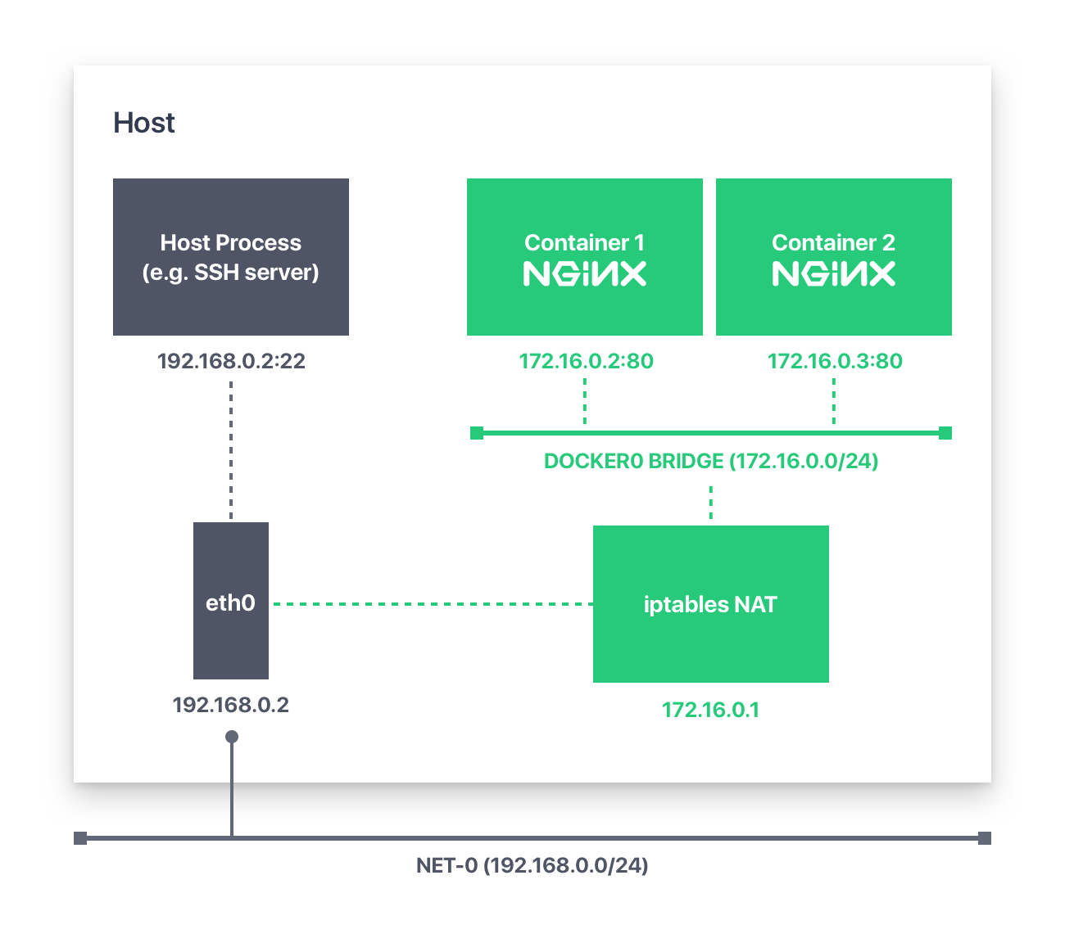
Networking in Docker
Host Network
None Network
Bridge Network

Slide 9
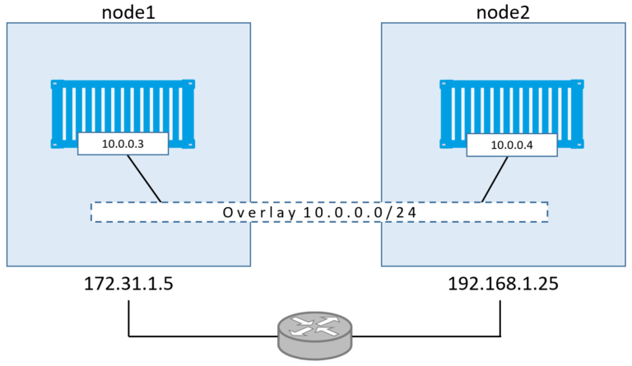
Overlay Network

Slide 10
Agenda for Kubernetes
Kubernetes Overview
Purpose of Kubernetes
Kubernetes Architecture
Pods
Labels & Selectors
Controllers
Deployments
Replication Controller
Replica Sets
Daemon Sets and Jobs
Networking
Services
Storage
Storage and Persistence
Persistent Volume
Persistent Volume Claim
Configuration
Secret
ConfigMap
Monitoring
Scaling and Autoscaling
Authentication, Authorization and Access Control
ABAC
RBAC

Slide 11
Kubernetes Overview
Kubernetes, is a system for running and coordinating containerized applications across a cluster of machines
It is a platform designed to completely manage the life cycle of containerized applications and services using methods that provide predictability, scalability, and high availability.
As a Kubernetes user, you can define how your applications should run and the ways they should be able to interact with other applications or the outside world.
You can scale your services up or down, perform graceful rolling updates

Slide 12
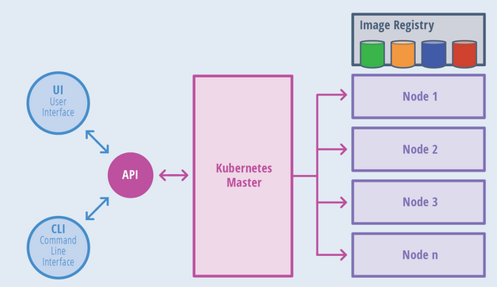
Kubernetes Architecture

Slide 13
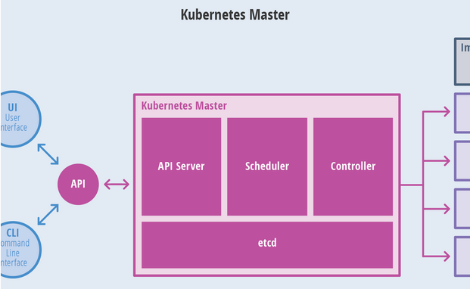
Kubernetes Master

Slide 14
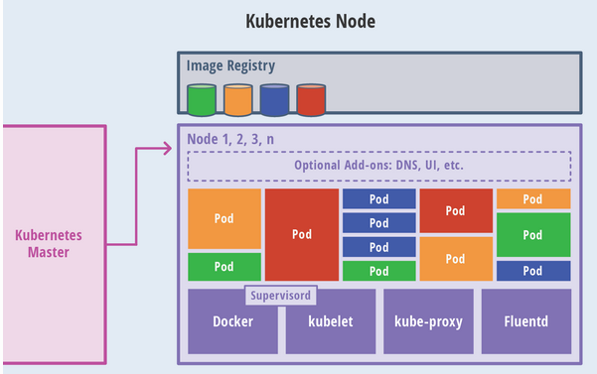
Kubernetes Node (Worker)

Slide 15
Kubernetes Components
Labels & Selectors
Labels : key-value pairs
Identify the attributes of objects
Selectors:
Identify set of objects
Grouping of objects
Equality Based Selectors
operators used : =,==,!=
Examples:
environment = production
tier != frontend
Set Based Selectors
operators used : in, notin, exists
Examples:
environment in (production, qa)
tier notin (frontend, backend)
Partition
!partition

Slide 16
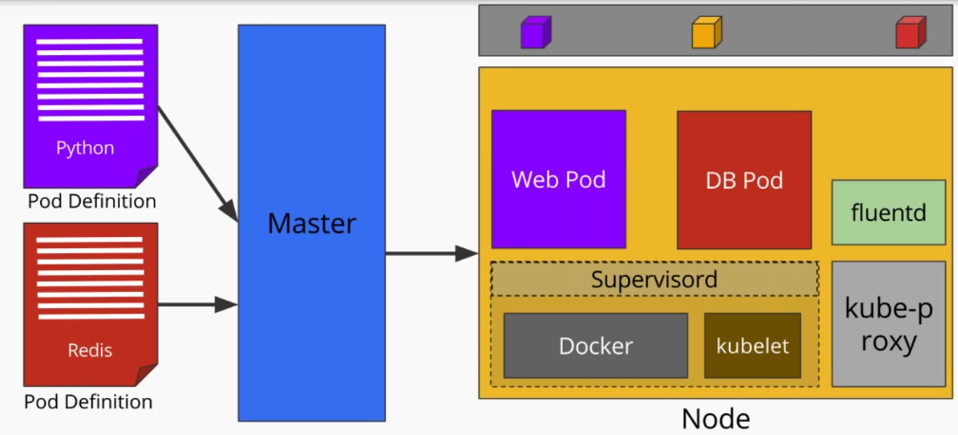
Kubernetes Components
Pods
Running process on cluster
Unit of application deployment

Slide 17
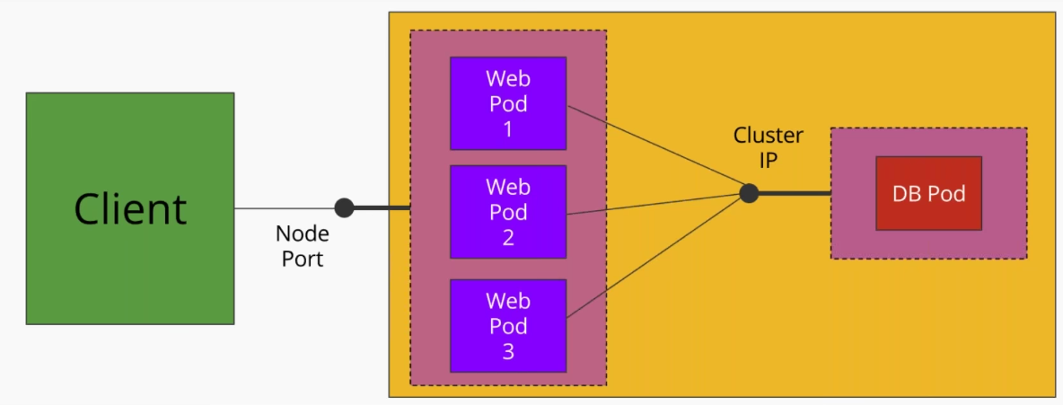
Kubernetes Components
Networking
Services : A Kubernetes Service is an abstraction which defines a logical set of Pods and a policy by which to access them

Slide 18
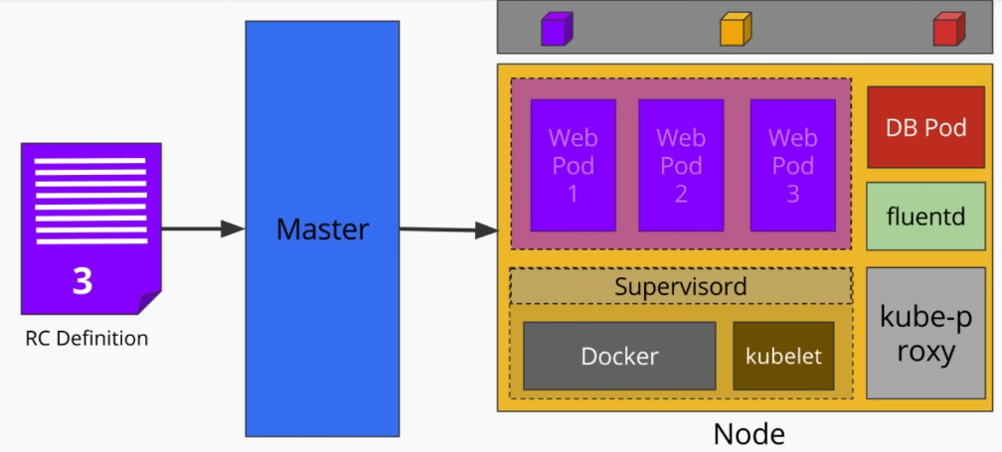
Kubernetes Components
Controllers
Replication Controller: https://kubernetes.io/docs/concepts/workloads/controllers/replicationcontroller/
Replica Sets : https://kubernetes.io/docs/concepts/workloads/controllers/replicaset/,
Deployments : https://kubernetes.io/docs/concepts/workloads/controllers/deployment/

Slide 19
Kubernetes Components
Controllers
Daemon Sets :
Ensures that all nodes run a copy of pod
Examples: Cluster Storage daemon, log collection daemon, node monitoring daemon
Jobs : Creates one or more pods and ensures that specified number of them successfully terminate
Storage
Storage and Persistence
API for users and administrators that abstracts details of how storage is provided from how it is consumed
Persistent Volume : is a piece of storage in the cluster that has been provisioned by an administrator.
Persistent Volume Claim : is a request for storage by a user

Slide 20
Kubernetes Components
Configuration
Secret : Hold sensitive information such as passwords, OAuth tokens, ssh keys, etc
ConfigMap : ConfigMaps allow you to decouple configuration artifacts from image content to keep containerized applications portable.

Slide 21
Other Concepts
Monitoring
Scaling and Autoscaling
Authentication, Authorization and Access Control
ABAC
RBAC

Slide 22
References
Docker Basics: https://docs.docker.com/engine/docker-overview/
Manage Data in Docker: https://docs.docker.com/storage/
Docker Networking: https://docs.docker.com/network/ , https://success.docker.com/article/networking
Other Docker Links: http://goinbigdata.com/docker-run-vs-cmd-vs-entrypoint/ , https://www.oreilly.com/library/view/using-docker/9781491915752/ch04.html
Kubernetes Basics: https://www.digitalocean.com/community/tutorials/an-introduction-to-kubernetes
Kubernetes Componenets: https://kubernetes.io/docs/concepts/workloads/pods/pod-overview/, https://kubernetes.io/docs/concepts/workloads/controllers/daemonset/
Kubernetes configurations: https://kubernetes.io/docs/concepts/configuration/secret/
Kubernetes Storage: https://kubernetes.io/docs/concepts/storage/persistent-volumes/
Kubernetes Access Control: https://kubernetes.io/docs/reference/access-authn-authz/abac/ , https://kubernetes.io/docs/reference/access-authn-authz/rbac/
Web Series for Kubernetes : https://www.youtube.com/watch?v=_vHTaIJm9uY&list=PLF3s2WICJlqOiymMaTLjwwHz-MSVbtJPQ

Slide 23

Question
Notes:
<number>

Slide 24

Thank You

